Slide 1
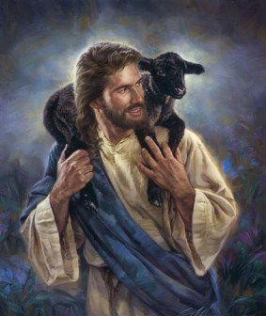
The Lord is My Shepherd
Psalm 23
Notes:
Open with Hymn 182 My Song shall be of Jesus~B&R~~Devotional Service~Vesper Service Theme of Convention

Slide 2
Background
Shepherd Psalm 23 is one of the best English literary works, and one of the most popular Psalms. Creates a Spirit of Calmness, Security and Peace. Very Comforting!!
  Read by those who are suffering & going thru trial
  Read by those who are grieving at funerals
  Read by families who lose loved-ones
  Read by the guilty, the lonely, the depressed, the forsaken
  Read by all for daily living~Reassurance
  Read at Devotional Services~Praise,Encouragement

Slide 3
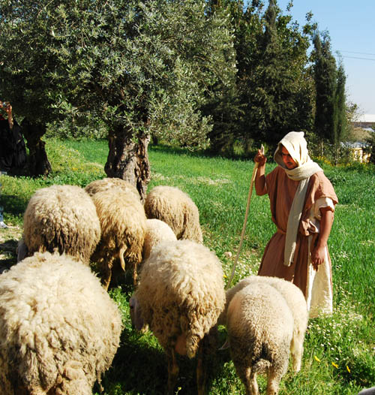
Background
This psalm came from the fullness of Davids heart who was an experienced shepherd (1 Sam. 16:11; 17:34-37,40; Psa. 78:70-72)
He already experienced the Lord’s assistance, He taught about God’s shepherding,Importance! (Psa. 79:13; 80:1; 100:3)
Notes:
Traits of Shephed, Charateristics of Sheep Hymn 87 He Leadeth Me

Slide 4
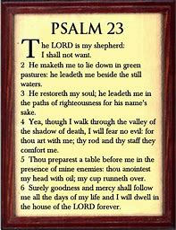

Slide 5
Good Shepherd John 10:11
Qualities
Exercises care. Concern for the flock!
Protects the Flock,from wild animals, wolves,lions!
Leads the sheep, not drives the sheep
Meets sheep’s every need, Gives food, water, rest, safety, direction
Gives them necessities of life and knows them by name
Laid down his life for the Sheep!

Slide 6
Sheep
Traits, Characteristics
Isaiah 53:6 All we like sheep have gone astray
Danger of getting lost, being attacked, drowning, plunging off cliffs
Cannot survive long without a shepherd, easily frightened,skittish
Respond when called by name!
No weapons for defense such as claws,sharp hooves, or powerful jaws.

Slide 7
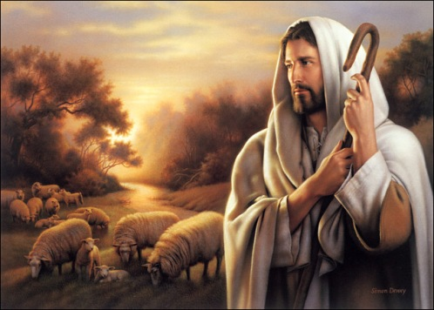
Psalm 23
“The Shepherd Psalm”
The Lord shepherd feeds us 1-2
The Lord shepherd leads us 2-3
The Lord shepherd protects 4,5
The Lord shepherd blesses 6
Notes:
Page 52 Poems of Dawn He Leadeth Me., Hymn Lead Me Home ~photocopy

Slide 8
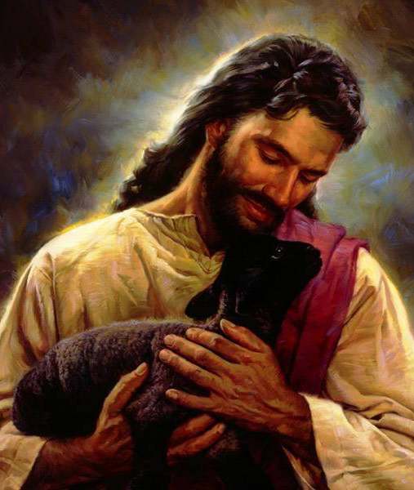
The Lord is my shepherd
The Lord Jesus is a “good shepherd” John 10:1-16 (Ezek. 34:1; Mt. 26:31 [Zech. 13:7]; Jn. 10:11; Heb. 13:20; 1 Pet. 2:25; 5:4) He feeds, guides, protects, nurtures, shelters, comforts, keeps safe, seeks and finds!
We must personally allow the Lord to be our shepherd - “my” shepherd-that’s why it says “Lord is My Shepherd”
What a Promise we have!

Slide 9
I will not want
The Lord will provide for all our needs; we will not “want” or lack any good thing (Phil. 4:19 Matt6:32,33)
  Spiritual needs (Eph. 1:3)
The Lord will provide for our needs, not our selfish wants (Jas. 4:1ff); let what “I will” be what God wills
Let us be content with what the Lord provides (Phil. 4:11; 1 Tim. 6:6-8; Heb. 13:5)

Slide 10
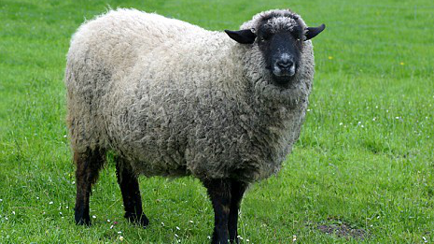
He makes me to lie down in green pastures
The Lord provides a place to “lie down” and rest (Mt. 11:28-30; Heb. 4:11)
The Lord provides “green pastures” [Heb. tender grass] for nourishment (Ezek. 34:14; Jn. 10:9)

Slide 11
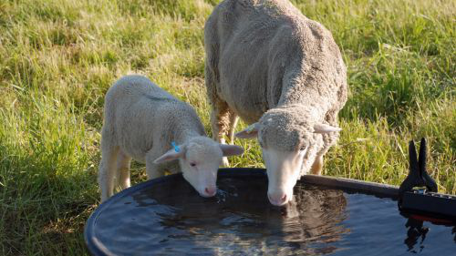
He leads me beside still waters
The Lord takes his people to “still” waters that are quiet, at rest, calm, and peaceful (Phil. 4:7; Col. 3:15; 1 Tim. 2:2)
The Lord takes his people to still “waters” that offer refreshment for the soul (Jn. 4:10; 7:38; Rev. 7:17; 22:1,6,17)

Slide 12
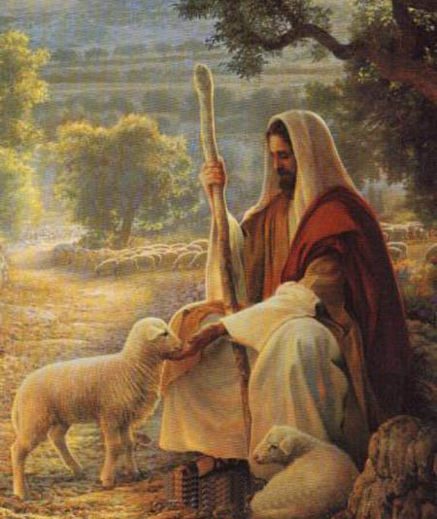
He restores my soul
The Lord “restores” his people to an upright position after they have been cast down (Psa. 19:7) Another wonderful Promise!
Cast down due to ease,sin,affluence – the sheep fallen into soft grass (Amos 3:12; 6:1) , The sheep fallen into mud and mire (Mt. 18:12-14; Lk. 15:4-7; Heb. 12:1-2)due to affluence – the sheep fallen because it is fat with wool (Rev. 3:17)

Slide 13
He guides me in paths of righteousness for his name’s sake
The Lord shows his people the correct and right way
  The “paths of righteousness” are found in God’s word (Rom. 1:17; Heb. 5:13; 2 Tim. 3:16)
  We must seek these “paths” (Mt. 5:6; 6:33)
  We must preach these “paths” (Acts 24:25)
  We must live in these “paths” (1 Cor. 15:34)

Slide 14
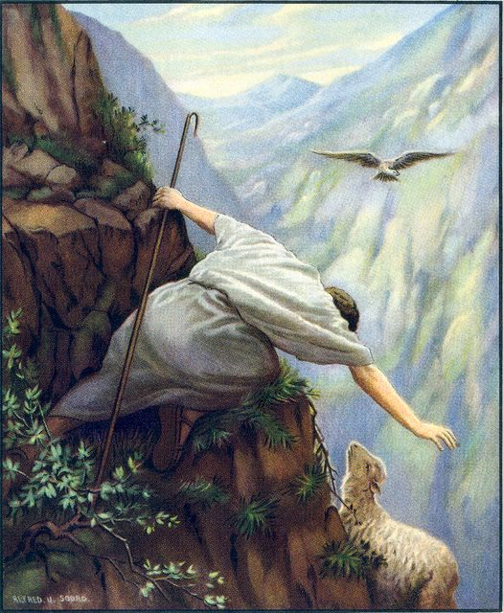
He guides me in paths of righteousness for his name’s sake
The Lord shows his people the correct and right way
  We must use these “paths” for protection (Eph. 6:14) Stand your Ground,put on the Breastplate of Righteousness.
  We must not leave these “paths” like others do (Psa. 95:7-11; 2 Pet. 2:21)
  “Flock under his Care”

Slide 15
He guides me in paths of righteousness for his name’s sake
The Lord leads this way to bring honor to his own high and holy name; on account of his own character (Ezek. 36:22-38)
The Lord only is to be glorified (Isa. 42:6-8) (Eph. 1:6)

Slide 16
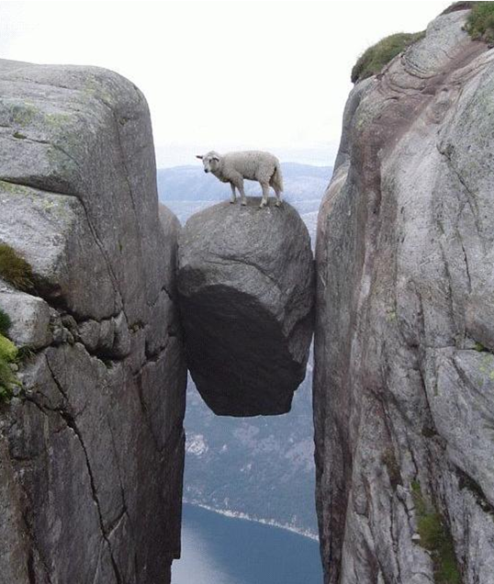
Yeah, though, I walk through the valley of the shadow of death
The Lord is with us thru highs and lows
of life - “the valley of the shadow of death”
(Psa. 107:13-14; 138:7; Mt. 4:16; Lk. 1:79)
The Lord’s followers “fear no evil”
(Psa. 27:1; 118:6; 2 Tim. 1:7)

Slide 17
Yeah, though, I walk through the valley of the shadow of death
The Lord is with his followers

Slide 18
Luke 15:3-7
Then Jesus told them this parable: “Suppose one of you has a hundred sheep and loses one of them. Does he not leave the ninety-nine in the open country and go after the lost sheep until he finds it? And when he finds it, he joyfully puts it on his shoulders and goes home. Then he calls his friends and neighbors together and says, ‘Rejoice with me; I have found my lost sheep.’
I tell you that in the same way there will be more rejoicing in heaven over one who repents than over ninety-nine righteous persons who do not need to repent.

Slide 19
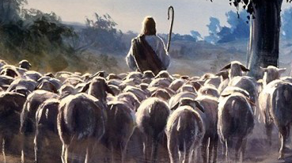
Your rod and your staff, they comfort me
The “rod” was a short club used for protection; the “staff” was a long stick with a crook on the end used for support and control (Jn. 10:11-12)
The Lord stands ready to protect, to support, to control, and to offer “comfort” (Psa. 119: 50; Rom. 15:4; 2 Cor. 1:3-6)

Slide 20
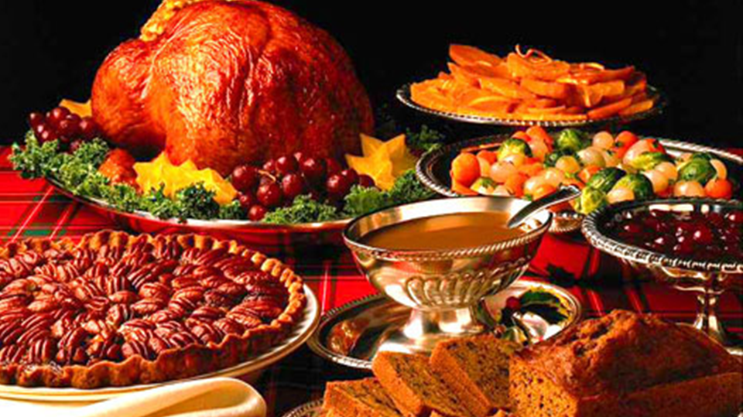
You prepare a table before me in the presence of my enemies
Just as a shepherd prepares a place to eat for his sheep, so the Lord prepares spiritual food for his followers (Jn. 6:53-56; 10:9-10)The Lord’s followers are sustained in the midst of enemies (Rev. 12:13-17)

Slide 21
Thou Preparest a Table Before Me
Table of Spiritual Food-orderly, bountiful,beautiful,by the hands of a “Faithful and Wise Servant-Meat in due Season
“Write the Vision & and Make it Plain Upon Tables that he may run that readeth it”Hab.2:2
Systematic orderingof the Divine Plan-was hidden,left to an appointed time at the end of the age.
Commission to make it plain upon a good clean table.
Menu has not changed even though some want a change of menu, with new and fancy dishes & they leave & move on.
Tell me the Old,Old Story

Slide 22
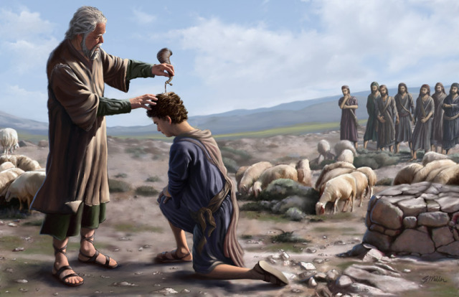
You have anointed my head with oil
Just as the shepherd anoints the head of the sheep for soothing comfort, so the Lord anoints his followersThe Lord’s word is like an anointing oil (1 Jn. 2:20,27-28)

Slide 23
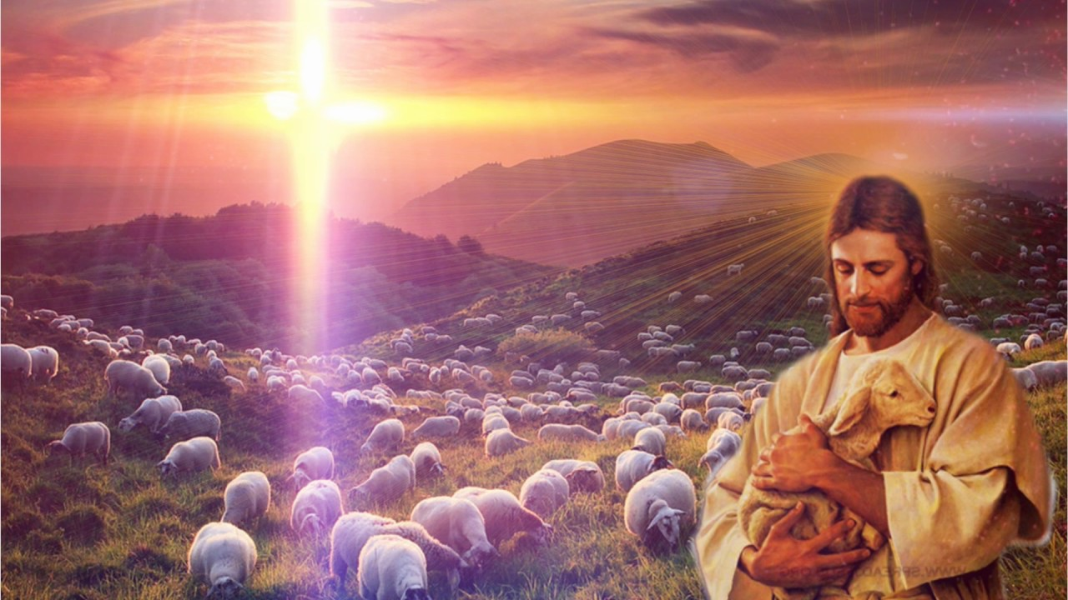
My cup runs over
“My cup runs over” speaks of complete provision and satisfaction.
Cup overflowing—Not half full,not half empty
The Lord provides an abundance of all that we need in Christ (Jn. 1:16; 10:10; Rom. 8:32; Eph. 1:3; 3:20-21; 2 Pet. 1:3)

Slide 24
Surely goodness and mercy shall follow me all the days of my life
The good shepherd provides all that is good and merciful to his sheep
The Lord is good and merciful to us through Jesus Christ (Psa. 107:1; 118:1,29; 136:1; Jn. 10:11)
The Lord provides “all the days of my life”

Slide 25
And I shall dwell in the house of the Lord forever
Dwelling with the Lord is the goal and desire of all that has been said in Psalm 23 (see Psa.26:8; 27:4)
Faithful Christians should desire to dwell in the house of the Lord now (1 Tim. 3:15) and if Faithful, with our Lord in heaven. (Jn. 10:27-28; 14:1-3; Phil. 1:23; 2 Tim. 4:8,18; Heb. 11:10-16; Rev. 3:12; 7:15; 21:3)

Slide 26
The Lord is My Shepherd
Many shepherds (elders) in the Lord’s church are not following the Chief Shepherd and are not leading properly (Ezek. 34:1ff; Zech. 11:17)

Slide 27
The Lord is My Shepherd
Many today are like sheep without a shepherd (Mt. 9:36); they need guidance!
Let the Lord lead us today!!!

Slide 28
Psalm 23
“The Shepherd Psalm”
R.3112, 3269, Seklemian P.419
The Lord shepherd feeds us 1-2
The Lord shepherd leads us 2-3
The Lord shepherd protects 4,5
The Lord shepherd blesses 6

Slide 29
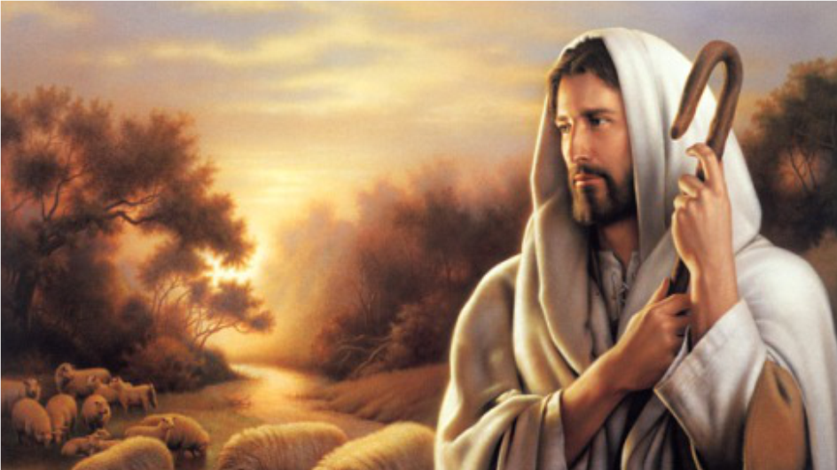
The Lord is My Shepherd

Slide 30
